Slide 1
Database
Data Warehouse

Slide 2
Data Warehousing
Large organizations have complex internal organizations, and have data stored at different locations, on different operational (transaction processing) systems, under different schemas
Data sources often store only current data, not historical data
Corporate decision making requires a unified view of all organizational data, including historical data

Slide 3
Data Warehousing
A data warehouse is a repository (archive) of information gathered from multiple sources, stored under a unified schema, at a single site
  Greatly simplifies querying, allows study of historical trends
  Shifts decision support query load away from transaction processing systems

Slide 4
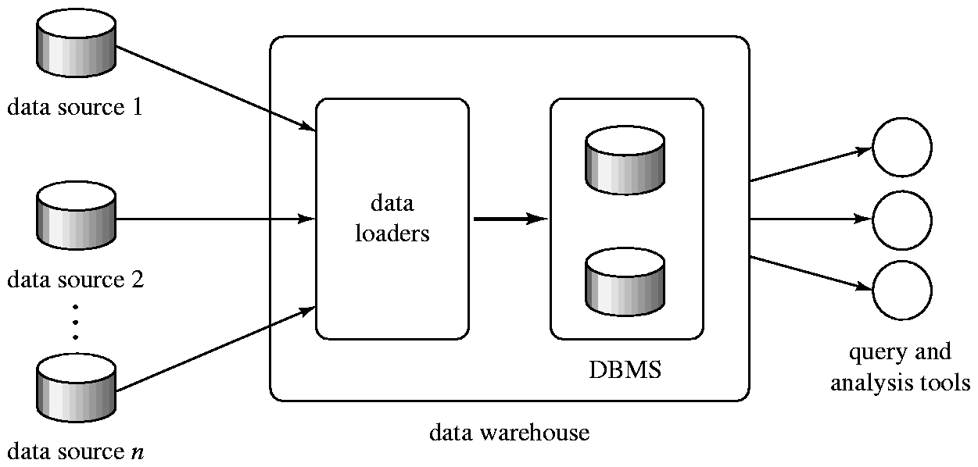
Data Warehousing

Slide 5
Components of Data Warehouse
When and how to gather data
  Source driven architecture: data sources transmit new information to warehouse, either continuously or periodically (e.g. at night)
  Destination driven architecture: warehouse periodically requests new information from data sources
  Keeping warehouse exactly synchronized with data sources (e.g. using two-phase commit) is too expensive
    Data/updates are periodically downloaded form online transaction processing (OLTP) systems.
What schema to use
  Schema integration

Slide 6
Components of Data Warehouse (Cont.)
Data cleansing
  E.g. correct mistakes in addresses
  Merge address lists from different sources and purge duplicates
    Keep only one address record per household
How to propagate updates
  Warehouse schema may be a (materialized) view of schema from data sources
  Efficient techniques for update of materialized views
What data to summarize
  Raw data may be too large to store on-line
  Aggregate values (totals/subtotals) often used
  Queries on raw data can often be transformed by query optimizer to use aggregate values

Slide 7
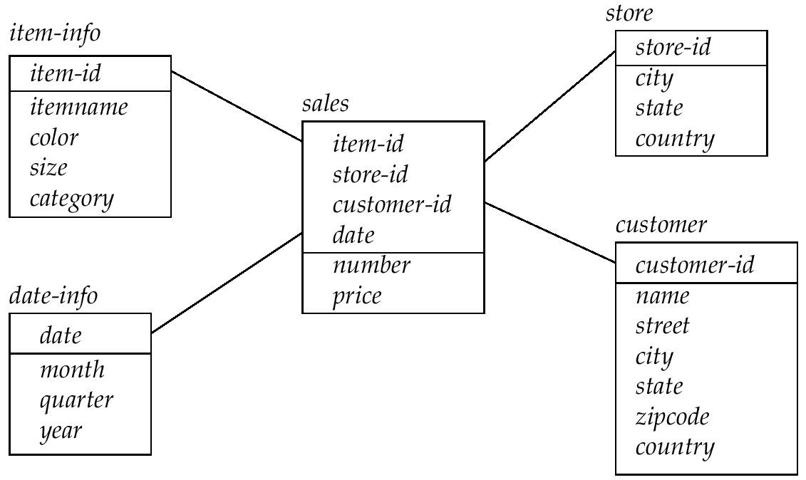
Data Warehouse Schemas
  To minimize the storage requirements, dimension attributes are usually short identifies that are foreign keys into other tables.

Slide 8
Warehouse Schemas
Typically warehouse data is multidimensional, with very large fact tables
  Examples of dimensions: item-id, date/time of sale, store where sale was made, customer identifier
  Examples of measures: number of items sold, price of items

